Slide 1


Advisor : Hoon Sung Chwa
Weekly Meeting
2023.01.13
Dept of Information & Communication Engineering, DGIST
Real-Time Computing Lab
Kang Young Eun ( kye0520 @dgist.ac.kr)

Slide 2
Contents
Overview
Review
Motivational Experiment
Localization
Patching
2

Slide 3
Motivation
Real Time Object Detection
The trend of object detection systems with multiple cameras.
Solve the tradeoff between detection accuracy and execution time in object detection with multiple cameras.
Problem with multi camera object detection
Deadline miss may lead to severe accidents.
Solve the tradeoff between detection accuracy and execution time in object detection with multiple cameras.
3

Slide 4

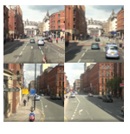
Overview
Overview
Multiple Input Images
Merge and resize whole image
Yolo Localization
Patching with original object size
Yolo detection
Classification
Detection Result
4

Slide 5
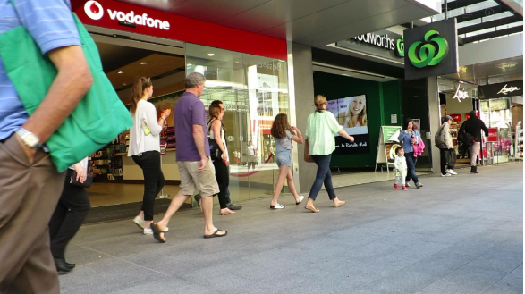
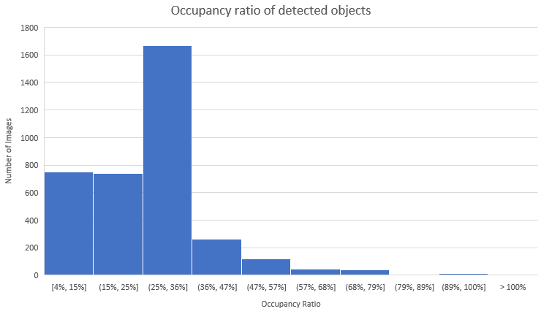
Review
Approach
Occupancy ratio of detected objects
Detected objects in a frame has less than 50% of the frame in most of the cases.
5

Slide 6
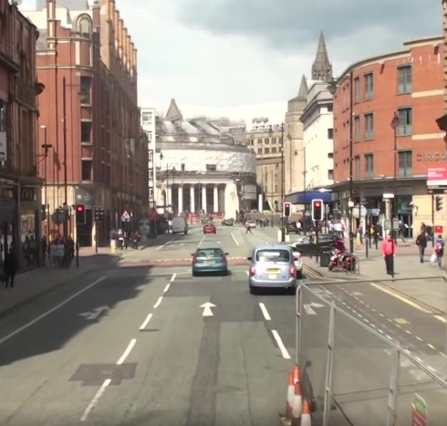
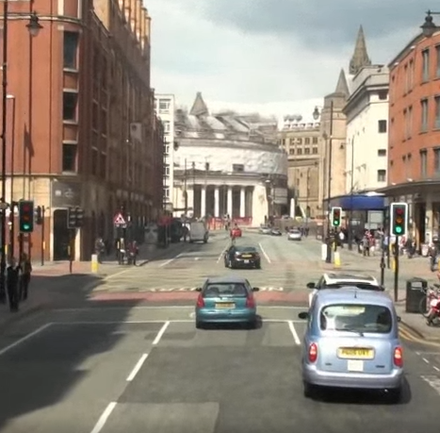


Motivation
Approach 2
Is patching multiple images and executing them at once efficient than executing them separately?
Single image execution
Merged image execution
Detection
Network
Detection
Network
Result
Result

Slide 7
Review
Approach
Single Execution vs Merged Image execution
Average Execution Time Comparison with YOLOv5
Image Size
1: 384x640
2: 728x640
4: 728x1280
6: 1256x1280
1.49x
1.46x
1.4x
Patched Image has 1.4x faster execution time than single image execution.
7
Notes:
Yolov5
1: 384x640
2: 728x640
4: 728x1280
6: 1256x1280

Slide 8
Motivation Experiment
Questions
Does localization have correlation with image size?
Execution time and accuracy
Does object patching maintain detection accuracy while minimizing execution time?
Multiple Input Images
Merge and resize whole image
Localization
Patching with original object size
Yolo detection
Detection Result
8

Slide 9
Motivation Experiment
Motivation Experiment
Localization execution time detection accuracy
Localization accuracy is not sensitive to image size until a certain point.
9

Slide 10
To Do
Motivation Experiments
Does localization have correlation with image resolution?
Localization is insensitive until a certain point.
Does patching maintain detection accuracy while minimizing execution time?
Multiple Input Images
Merge and resize whole image
Localization
Patching with original object size
Yolo detection
Detection Result
10
10
10

Slide 11

Advisor : Hoon Sung Chwa
Thank you
Dept of Information & Communication Engineering, DGIST
Real-Time Computing Lab
Kang Young Eun (kye0520@dgist.ac.kr)

Slide 12
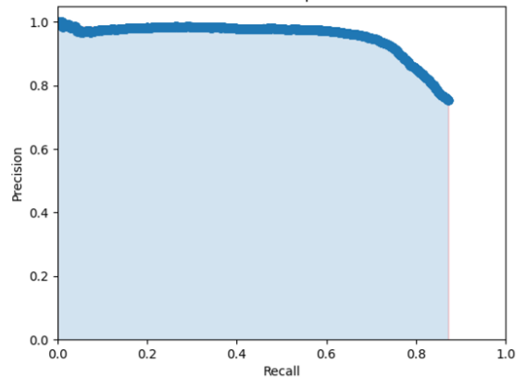
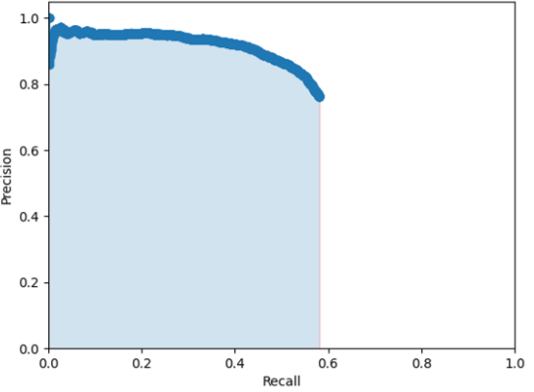
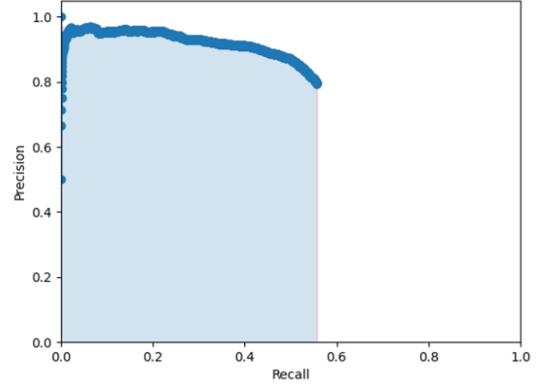
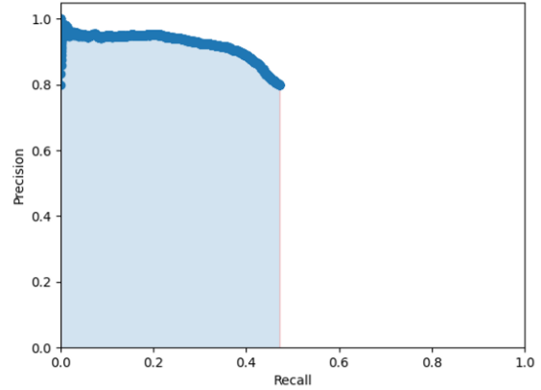
Motivation Experiment
Accuracy of localization per different patched image sizes (MOT16-09)
Precision-recall for each image resolution
1152x2048
1088x1920
83.48%
53.70%
763x1280
384x640
51.54%
43.73%
12
Notes:
Distractor occlude reflection

Slide 13
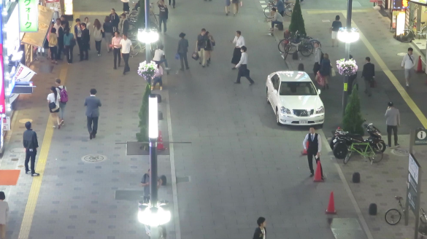
Motivation Experiment
Motivation Experiment (MOT16-04)
Accuracy of localization per different patched image sizes
13
Notes:
Distractor occlude reflection
어떤 frame이냐 에 따라서 dependent한 결과를 보인다.
Object가 많고 작은 object가 많은 경우 크게 localization에 차이가 없다? 복잡도가 지나치게 큰 경우 objec가
Object가 크고 적당한 비율을 차지하는 경우,

Slide 14
Motivation Experiment
Motivation Experiment (MOT16-09)
Accuracy of localization per different patched image sizes
14
Notes:
Distractor occlude reflection

Slide 15
Review
Motivational Experiment
Accuracy per patched image resolution
Execution Time of 4 patched image
Detection Accuracy
15

